Slide 1
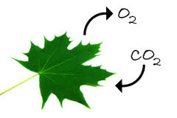
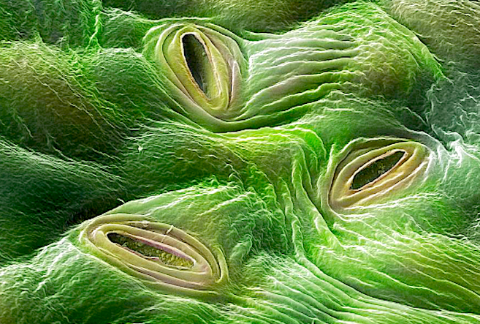
11ATAR BioloGY
Week 29 – Gas Exchange in Plants

Slide 2

Year 11 Biology Work Schedule
It is important to remain on schedule during this Semester.
Moodle
Have you visited Moodle this week? Yes / No
Tasks
Are you on schedule? Yes / No
When is your next task due?
Answer 2 out of 3 questions (Topics 2-4)
60 min (40 marks)

Slide 3
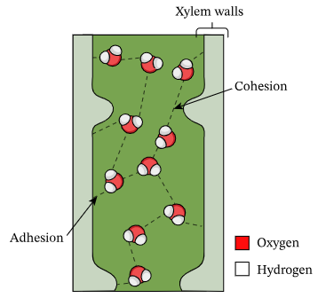
Review
The end products of photosynthesis are transported around the plant through
(a) tracheids.
(b) plasmodesmata.
(c) phloem sieve tubes.
(d) xylem vessels.
Explain cohesion and adhesion.
Notes:
C
Capillary action occurs because water is sticky, thanks to the forces of cohesion (water molecules like to stay close together) and adhesion (water molecules are attracted and stick to other substances).

Slide 4
Learning Intentions
Understand gas exchange in vascular plants.
Success Criteria
Students will be able to:
Identify and label stomata and guard cells.
Describe the process of gas exchange via the stomata and the plant surface.
Explain factors that affect the rate of gas exchange.
Describe the process of guard cells opening and closing to allow gas exchange.

Slide 5
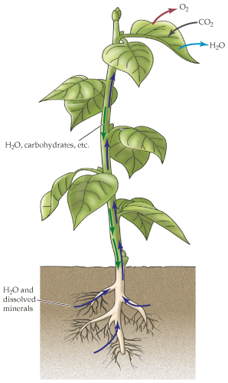
Plants need Oxygen too
Plants obtain the gases they need through their surfaces, especially leaves.
They require oxygen for respiration and carbon dioxide for photosynthesis.
Remember: -
Photosynthesis
  Occurs in the chloroplasts
  Energy produced (glucose)
Cellular respiration
  Occurs in the cytoplasm and mitochondria
  Energy produced (ATP)

Slide 6
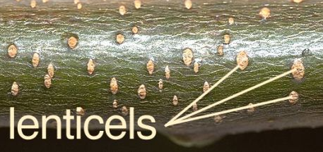
Gas exchange in plants
Plants have specialised structures for gas exchange but not a specialised system solely devoted to it.
Gas exchange is local and gases do not need to be transported through the plant.
In non-vascular plants, gases move by simple diffusion in and out across the short distance.
In vascular plants, oxygen and carbon dioxide are exchanged through the stomata or lenticels on leaves, stems and roots into and out of air spaces between cells.
Remember plants need to get both oxygen and carbon dioxide in (unlike animals that only intake oxygen and expel carbon dioxide.)
Scanning electron micrograph (sem) of lilac leaf stomata

Slide 7
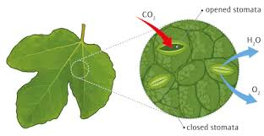
Gas Exchange in Vascular Plants
Vascular plants absorb and release gases, including oxygen and carbon dioxide, via the stomata on the plant surface.
Between the environment and the plant:
  Gas exchange occurs through diffusion at the stomata
Within the plant:
  Gas exchange involves the movement in and out of the intercellular spaces (spongy tissue)
  Occurs via passive transport

Slide 8
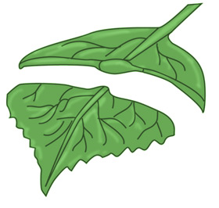
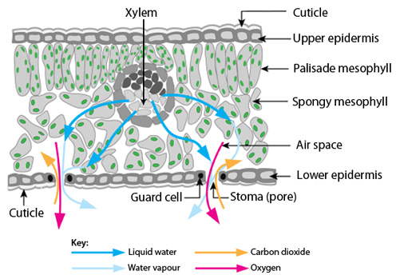
Stomata
Leaf cross-section

Slide 9
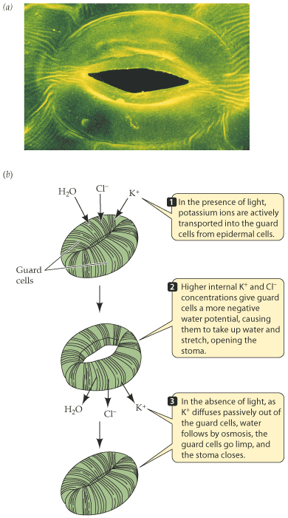
Stomata
Are the openings or “pores” in the leaf.
Most abundant on the leaves, where they are usually found on the underside.
Where diffusion of gases occurs
  O₂ net movement out
  CO₂ net movement in
Guard cells control whether they are open or not (to leave them open all the time would be inefficient).

Slide 10
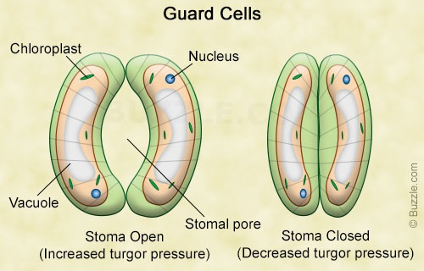
Guard Cells
A pair of kidney-shaped cells.
Guard cells are cells surrounding each stoma. They help to regulate the rate of transpiration by opening and closing the stoma.
The opening and closing of stoma is in response to water moving in and out of the guard cells.

Slide 11
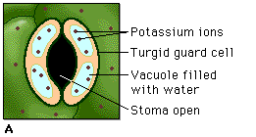
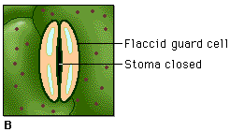
Regulating Stomata
When water moves in, the turgor (rigidity) of the guard cells increases causing them to swell and this opens the stomata.
The action that causes water to enter the guard cells is triggered by the uptake of potassium ions (K⁺) into the cells. This is stimulated by light hitting the leaves and potassium ions move into the guard cells by active transport.
  This increases the concentration gradient so water enters by osmosis. The guard cells swell opening the stomata.
  When K⁺ ions move out of the guard cells (in the dark), water leaves via osmosis, guard cells go limp and the stomata close.
The opening and closing of the stomata can also be in response to carbon dioxide levels as the guard cells contain chloroplasts which produce glucose.

Slide 12
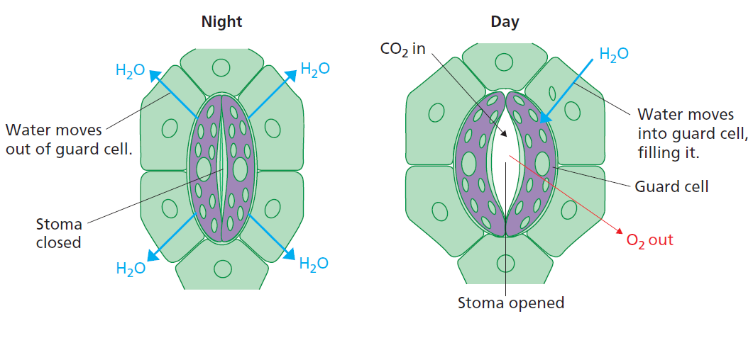
Regulating Stomata
Light plays an important role in regulating the opening and closing of the stomata. As such, stomata are generally open during the day and closed at night.

Slide 13
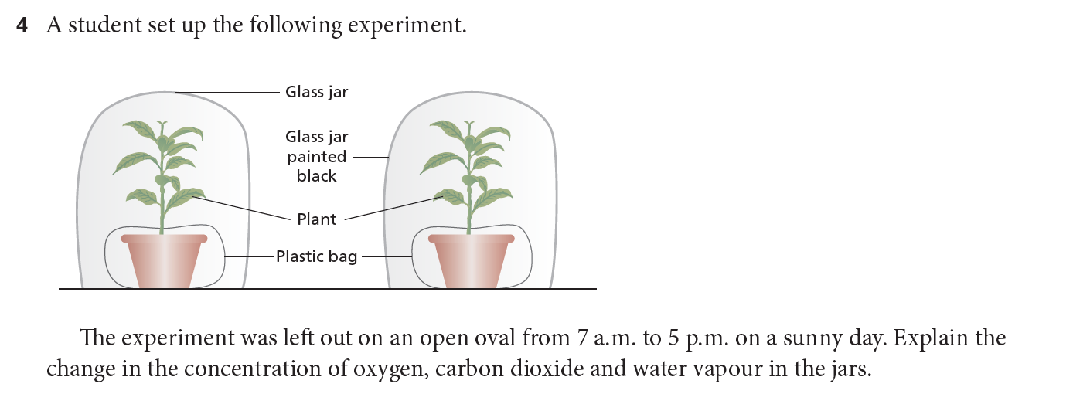
Notes:
Gas exchange primarily happens in the leaves.
Light: Stomata open => CO2 in, O2 out, water vapour out (transpiration). Light = predominantly Photosynthesis - So O2 and water vapour increase, and CO2 decreases.
Dark: Stomata closed => Little gas exchange… Cellular Respiration – uses O2, releases CO2 and water vapour…

Slide 14
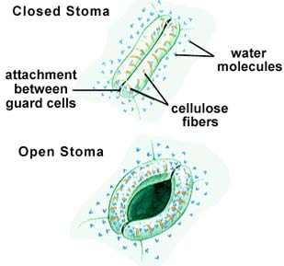
Regulating Stomata
The movement of gases in leaves depends on simple diffusion and happens locally over short distances. No transport system is used.
Plants need to balance their gaseous requirements with their ability to withstand water loss.
In drought - guard cells lose water and close stomata.
  This reduces water loss but cuts CO₂ supply.
  This restricts photosynthesis,
  and reduces overall plant growth.

Slide 15
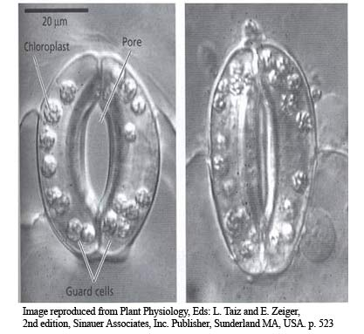
Regulating Stomata
Why not leave the stomata open?
  Remember that for gases to pass across the cell membrane they must be dissolved in water, thus a film of water must surround the guard cells. Therefore, plants are constantly losing water.
  The loss of water is called transpiration.
  Without closing guard cells the plants would become very dehydrated.
  Video on stomata https://www.britannica.com/video/21899/Microphotography-animation-stomate-function
  https://www.youtube.com/watch?v=JQvdXX7hGqI

Slide 16
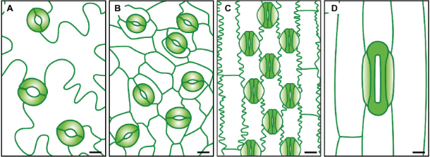
Sensitivity of Stomata
Number and appearance of stomata depend on several environmental conditions.
  Moist (high humidity, high rainfall) = stomata open. Plants found in these climates also often have more stomata.
  Hot, dry weather with low humidity = more stomata closed. Plants found in these climates also often have fewer stomata. In some, the stomata are protected to reduce water loss.
  Low CO₂ levels = stomata open.

Slide 17
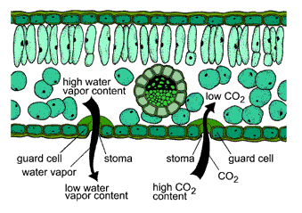
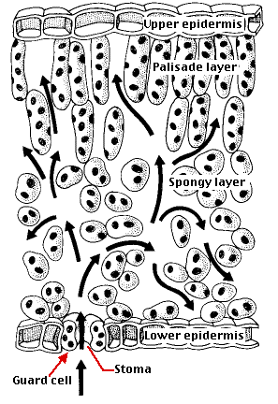
Gas movement Through the plant
Once through the stomata simple diffusion spreads the gases to the other plant cells.
The cells of plants structures are loosely packed meaning that gas can diffuse through the spaces with no need for a transport system.

Slide 18
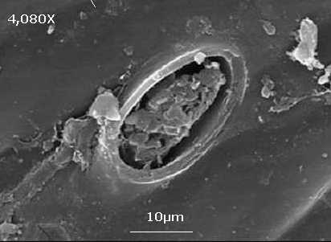
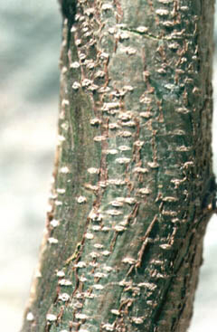
Beyond the Leaf
In the roots and stem gas exchange occurs in the outer layer of cells.
Lenticels break though the bark and allow air to diffuse through.
Lenticels are a porous tissue consisting of cells with large intercellular spaces. Found on the bark of woody stems and roots of flowering plants. It functions as a pore, providing a pathway for the direct exchange of gases between the internal tissues and atmosphere through the bark, which is otherwise impermeable to gases.
Once inside the outer layers and within the plant, diffusion is used in the spongy tissue to spread the gases to all cells.

Slide 19
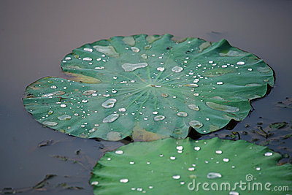
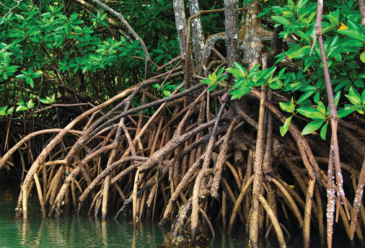
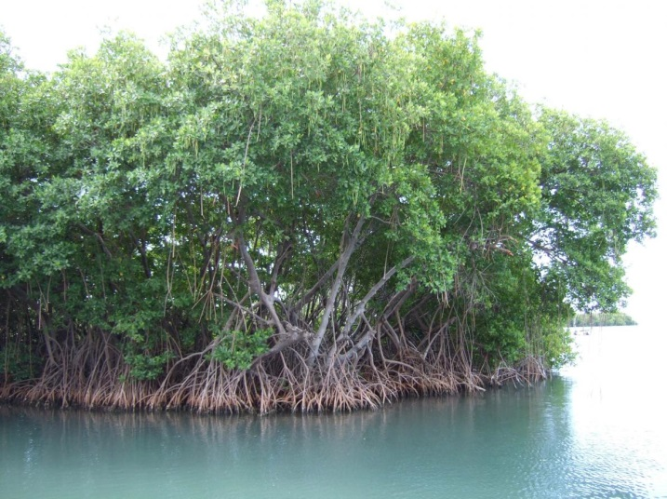
Gas Exchange in aquatic plants
Water plants have special adaptations to allow exchange of gases with their moist environment.
Some plants (like Water lilies) have their leaves floating on the water surface. They have their stomata on the top surface of the leaf.
Mangroves have aerial root system above the water line.
Submerged plants are able to exchange gases with the water across the epidermis.

Slide 20

Success Criteria
Students will be able to:
Identify and label stomata and guard cells.
Describe the process of gas exchange via the stomata and the plant surface.
Explain factors that affect the rate of gas exchange.
Describe the process of guard cells opening and closing to allow gas exchange.

Slide 21
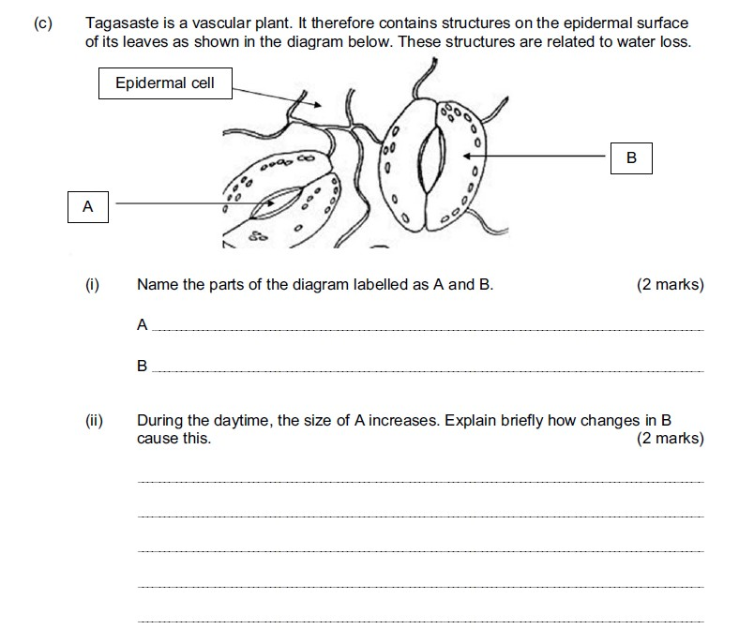
Exam review question

Slide 22

Moodle & Textbook Work
Nelson Chapter 13
-pg. 431
Study Guide Chapter 5.5

Slide 23
Student Feedback
What I learnt today…..
What I need to revise….

